Slide 1

Fashion Image Recognition Project
IST 707
Ross Conway, Noah Laraway, Anya Patel

Slide 2
Context & Overview
This project intends to examine the algorithms covered in this course along with some more complicated models to determine which of our available analytical tools can perform best when applied to a large image classification/Identification data set like MNIST.
The original MNIST data set although robust contains simple easily identifiable images and most models have very little trouble achieving nearly perfect accuracy. The FasionMNIST data set however offers the same robust volume and quality of data but with a fair bit of added image complexity.
The Goal is to take our photo data set of different articles of clothing and use machine learning and image recognition to predict the class label for that image, e.g., dress, sneaker or coat​
Real world application
Machine learning algorithms are used to identify objects across many industries​
One of which is the Fashion industry​
Application use cases like searching and tagging clothing and deciding the correct measurement of shoes and attire has led to the adoption of image recognition​

Slide 3
Data Acquisition & Description
The Fashion MNIST dataset was downloaded from Kaggle​
Contains 2 CSVs: one used for training, one used for testing​
First column is a class label: a number (0-9) that represents the article of clothing in the image​ e.g., dress, sneaker or coat
The remaining columns are the pixels in the image read left to right, top to bottom (totaling 784 pixels per 28x28 image)​

Slide 4
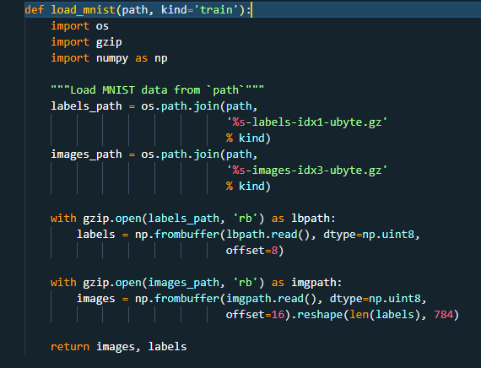
Data Pre-processing
This code identifies our labels and our image data into their respective columns
This allows us to easily visually explore and load our data into our models

Slide 5
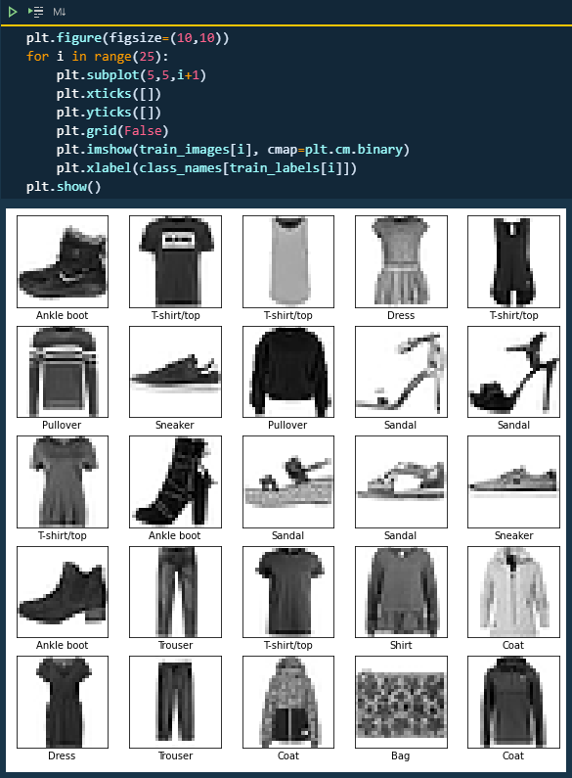
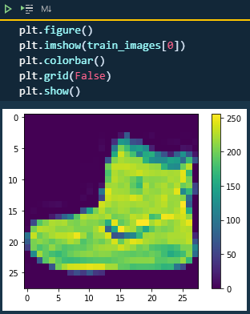
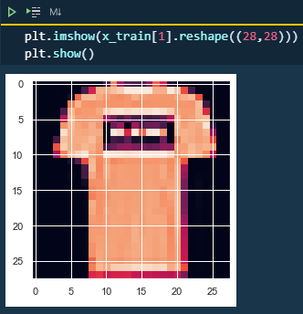
Data Exploration & Visualization
Grid plot of a sneaker
Grid plot of a T-shirt/top
Plot showing various images and labels

Slide 6
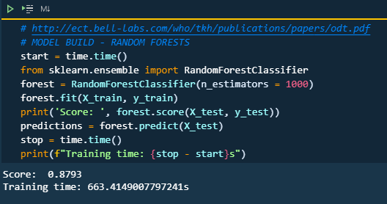
Model: Random Forest
Number of Models Ran: 3
Best Score: 0.88
Time: 66.95s

Slide 7
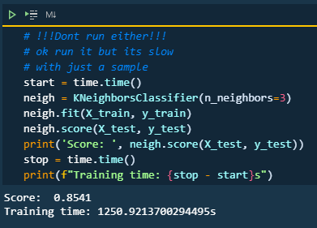
Models: K-Nearest Neighbors
Number of Models Ran: 3
Best Score: 0.85
Time: 1250.92s

Slide 8
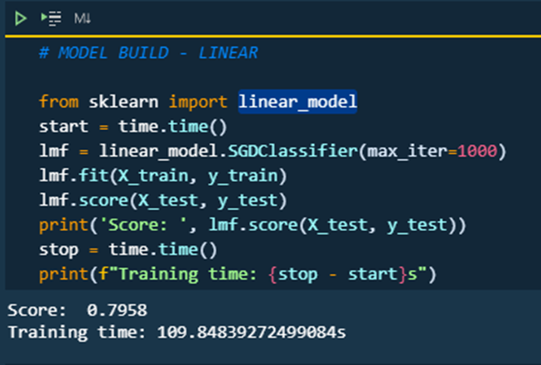
Models: Linear
Number of Models Ran: 186
Best Score: 0.83
Time: 109.85s

Slide 9
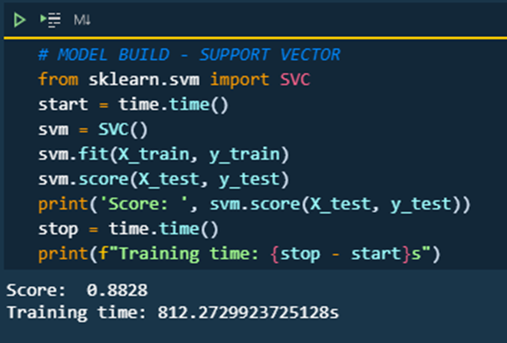
Models: Support Vector Machine
Number of Models Ran: 1
Best Score: 0.88
Time: 812.27s

Slide 10
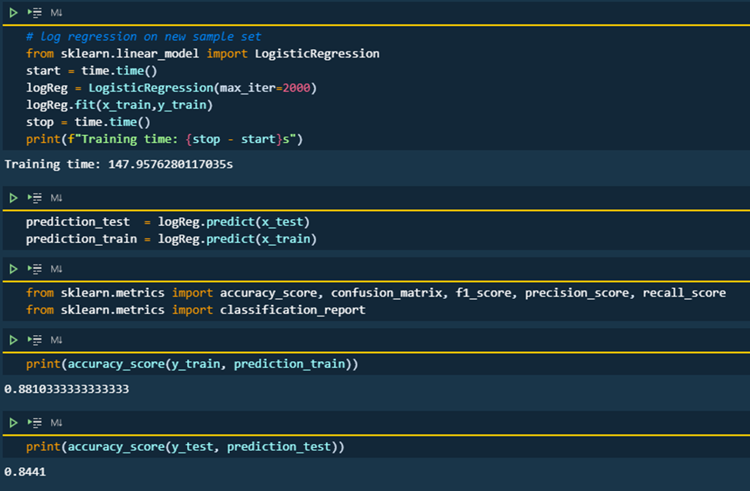
Models: Logistic Regression
Number of Models Ran: 1
Best Score: 0.84
Time: 147.96s

Slide 11
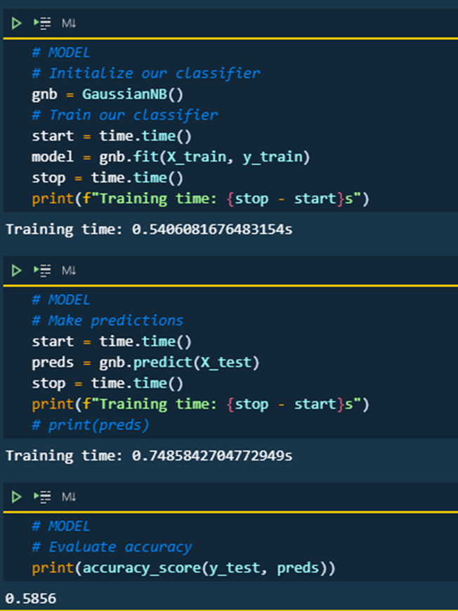
Models: Gaussian Naive Bayes
Number of Models Ran: 1
Best Score: 0.59
Time: 0.54s

Slide 12
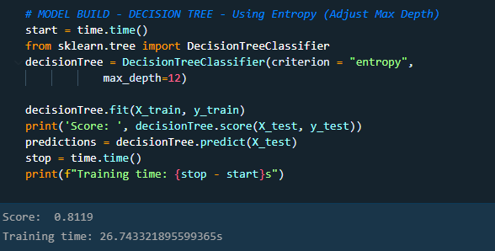
Models: Decision Tree
Number of Models Ran: 7
Best Score: 0.81
Time: 27s

Slide 13
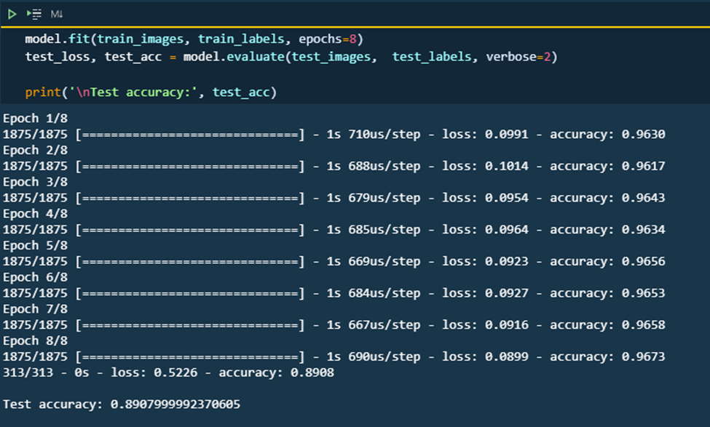
Models: Keras Tensor Flow
Number of Models Ran: 24
Best Score: 0.89
Time: 8s

Slide 14
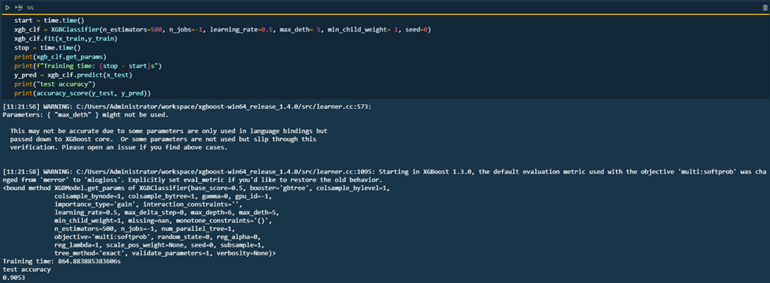
Models: XGBoost
Number of Models Ran: 6
Best Score: 0.91
Time: 864.88s

Slide 15
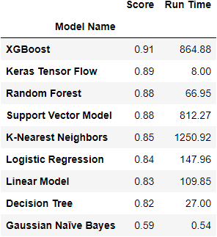
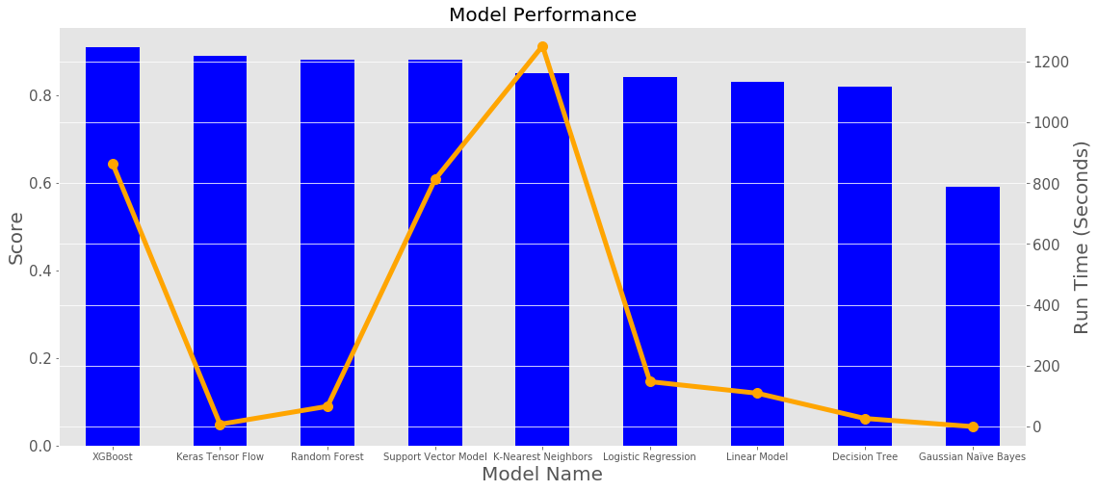
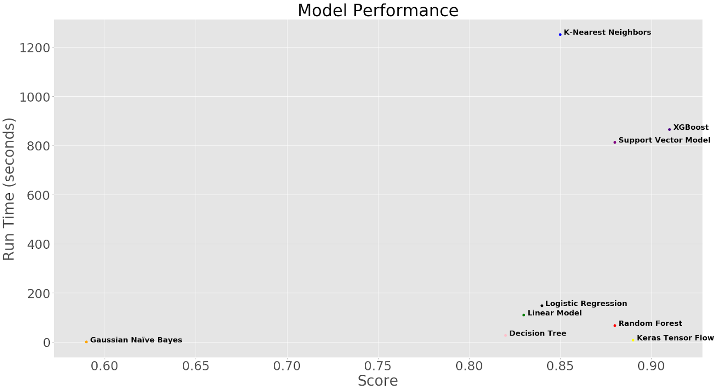
Model Evaluation
Bar chart for scores with overlaying line plot for run times
Scatter plot of Score vs. Run Time
Model score and run time table sorted by score

Slide 16
Results
Majority of the models used were able to predict each image at an accuracy over 80%
Best performing model by prediction score: 1) XGBoost: 91% accuracy, 2) Keras Tensorflow: 89% accuracy
Best run time: 1) Naïve Bayes model: 0.54s, 2) Keras Tensorflow: 8s
Overall, Keras Tensorflow produced the best combination of computational time and accuracy but this does not mean that it is inherently the best model, XGBoost produced the most accurate models by a significant margin.

Slide 17
References
GitHub - zalandoresearch/fashion-mnist: A MNIST-like fashion product database. Benchmark
https://www.tensorflow.org/tutorials/keras/classification
Kaggle - Fashion MNIST
fashion-mnist/mnist_reader.py at master · zalandoresearch/fashion-mnist · GitHub
https://iryndin.dev/post/xgboost_fashion_mnist/
https://github.com/anktplwl91/fashion_mnist/blob/master/fashion_xgboost.ipynb
https://www.kaggle.com/subhayan2018/exploring-xgboost-with-fashion-mnist
http://ect.bell-labs.com/who/tkh/publications/papers/odt.pdf
https://github.com/facebookresearch/faiss/blob/master/INSTALL.md
https://towardsdatascience.com/make-knn-300-times-faster-than-scikit-learns-in-20-lines-5e29d74e76bb
https://www.tensorflow.org/install/gpu

